Slide 1
What the Numbers Reveal About Road Crashes
UK Car Accidents 2005-2015
Done by :Fatema Sultan

Slide 2
Introduction:
Road accidents are a major global issue that threaten both public safety and health.
They result from various causes such as excessive speed, poor weather, and type of road.
Analyzing accident data is essential to detect high-risk patterns and develop targeted safety strategies.

Slide 3
Problem Statement :
Road accidents in the UK endanger both lives and the economy. Poor road conditions, weather, and traffic are key factors. With no clear risk assessment system, data analysis is essential. Fatalities remain under 2 for every 100 accidents, highlighting both progress and the need for further prevention.

Slide 4
Data Overview :
Country: United Kingdom.
Data Source: UK Department for Transport. Time Period: 2005–2015.
Fatalities made up approximately 0.5% to 1.2%
Link to data set: https://www.kaggle.com/datasets/silicon99/dft-accident-data/data

Slide 5
Goals & Approach

Slide 6
Goals
To classify risks by severity and environmental factors?
How does speed limit influence the severity of road accidents?
To detect the most location with accidents?
To investigate the peak time of accidents?
To assess the effect of speed limit on accidents ?
Does urban or rural area have more accidents?
Do accidents involving pedestrian crossings tend to be more severe?

Slide 7
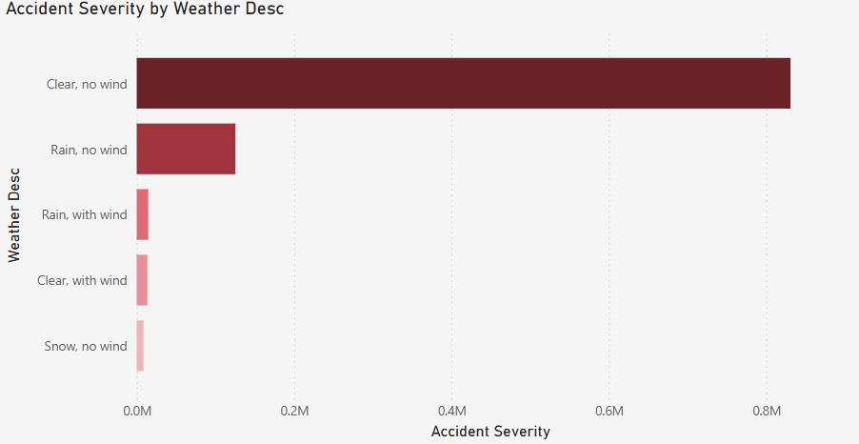
Risk Classification by Severity & Environment:

Slide 8
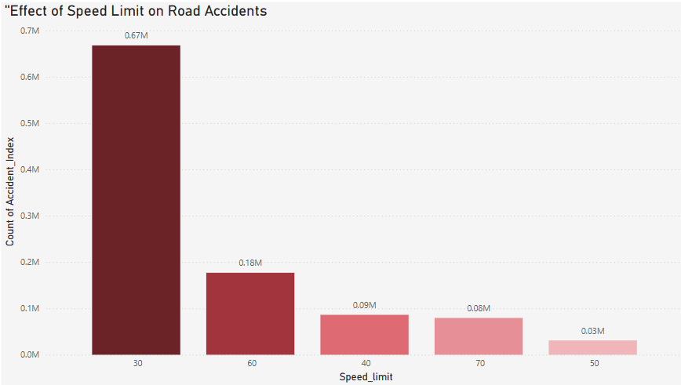
Accidents by Speed Limit: Insights from UK Road Data :

Slide 9
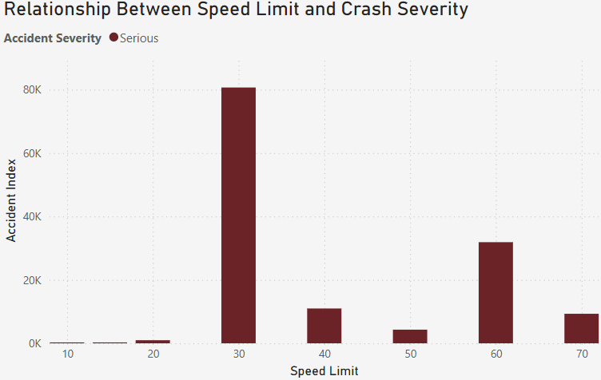
Effect of Speed Limits on Accident Severity:

Slide 10
Most Affected UK Cities by Traffic Accidents:

Slide 11
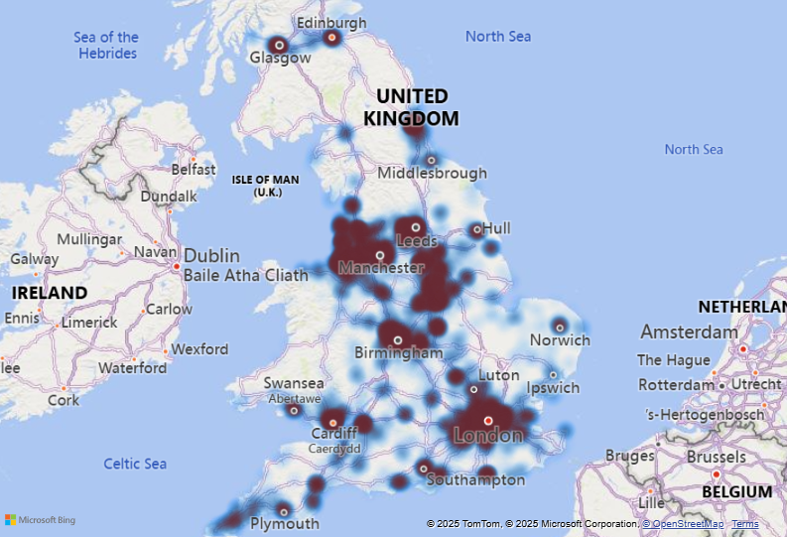
Most Affected UK Cities by Traffic Accidents:

Slide 12
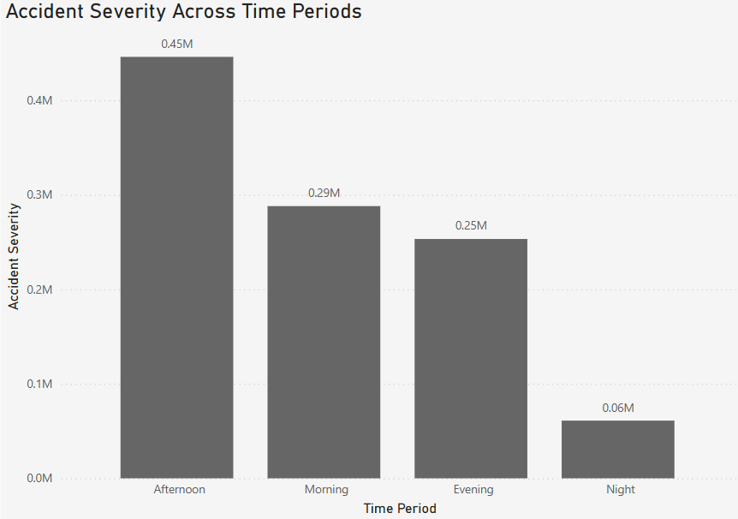
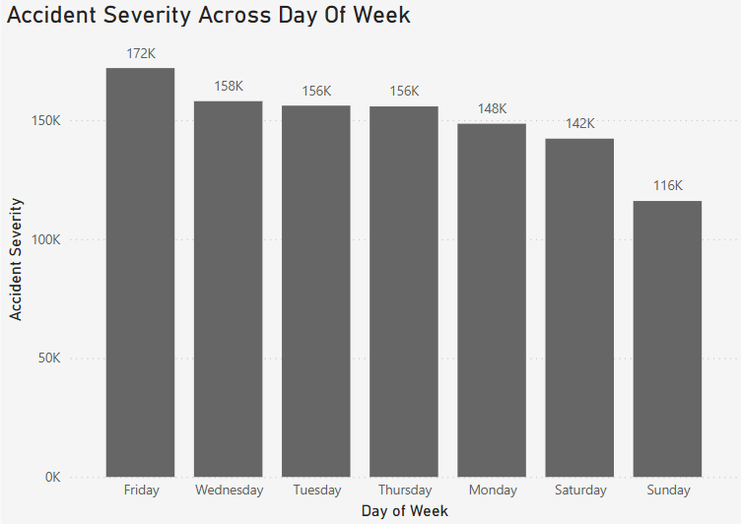
Peak Accident Times:

Slide 13
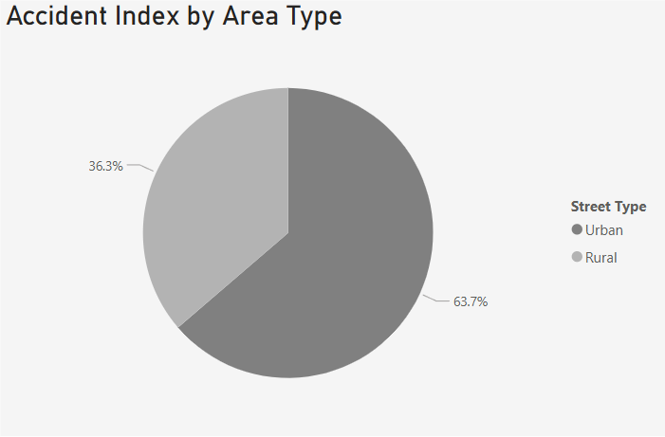
Urban vs. Rural Roads:

Slide 14
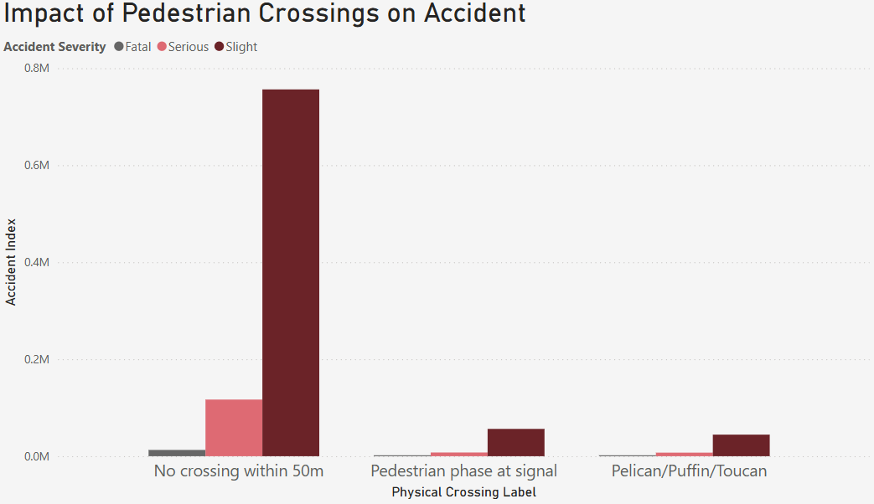
Accident Severity by Type of Pedestrian Crossing:

Slide 15
Recommendations:
Target Critical Timeframes: Strengthen safety efforts during peak accident hours.
Review Speed Zones: Adjust speed limits in high-risk areas based on severity data.
Prioritize Hotspots: Focus safety measures in crash-prone urban areas.
Enable Data-Driven Decisions: Promote continuous analysis to guide traffic policies

Slide 16
Thank you …

